Slide 1
Salary Survey Analysis
Surya V
30-01.2025
Data analytics & Data science
Oct 2024

Slide 2
PROJECT OVERVIEW:
OBJECTIVE:
Sales trend analysis
PURPOSE OF THE PROJECT:
This project aims to analyze salary pattern across industries , role,
experience levels and locations.

Slide 3
SUMMARY:
Analysed the Salary Survey of 2021.
Scrabbed data into Cleaned Dataset.
Queries Fetched.
Created Dashboard in Excel.
Visualization on Analaysis

Slide 4
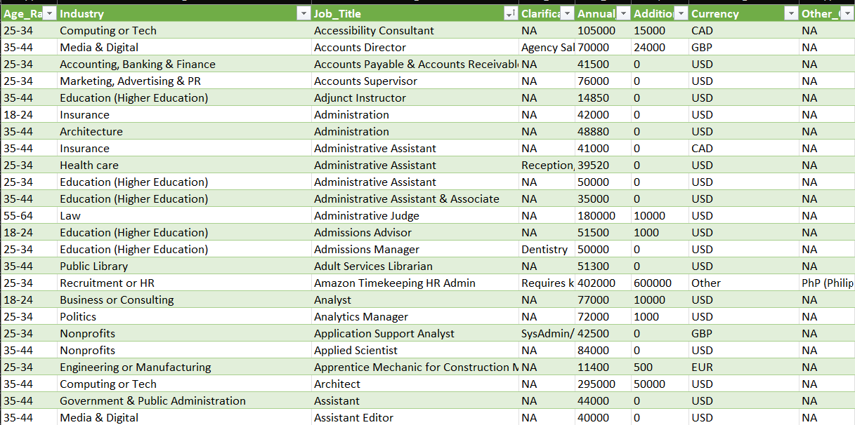
DATA CLEANING
Cleaned the dataset using Power Query.
Handled missing values.
Inconsistent values.
Standardized data types.

Slide 5
DATA QUERY:
Imported cleaned data into Mysql.
Written query and fetched the result.
Exported the dataset to excel.

Slide 6
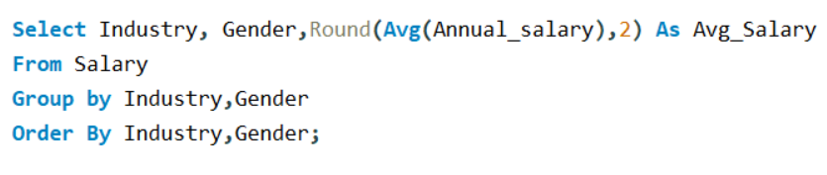
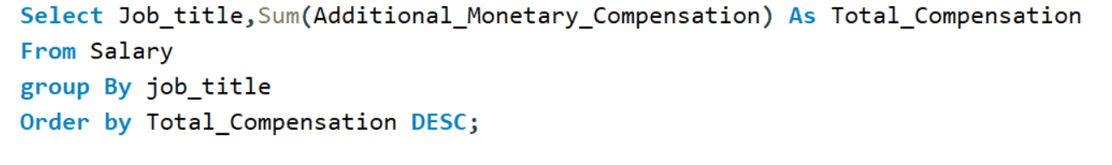
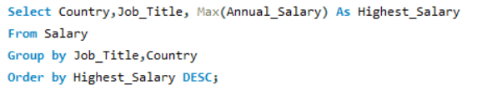
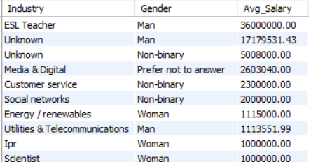
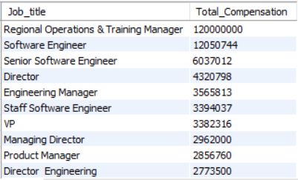
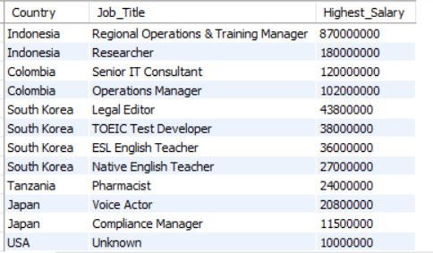
DATA QUERY

Slide 7
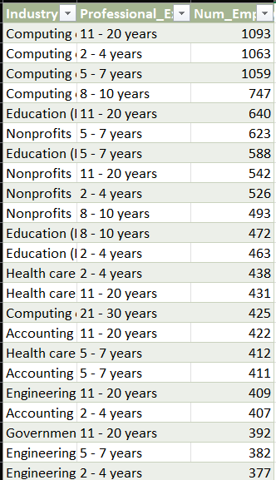
DATA MODELING:
After exporting, the tables were collected in single workbook.
Added tables to data model in Power Pivot.
Created relations(connections) across Tables.

Slide 8
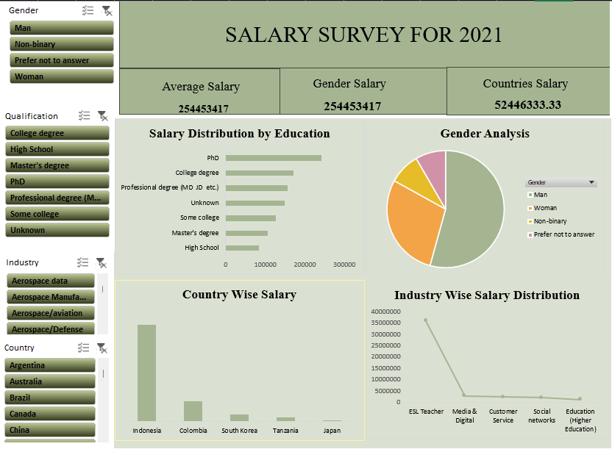
DASHBOARD

Slide 9
INSIGHTS:
Indonesia –Highest Salary.
Tanzania – Lowest Salary
Women often earn less than Man.
PhD Scholars - Highest salary range.
Computing or tech - High no. of employees .
Employees with more experience earn more

Slide 10
RECOMMENDATION:
Conduct Regular Pay Audits to ensure gender pay equity.
Link Salary Increases to Education and Experience to reward growth.
Ensure Salary Progression for All Roles to retain experienced talent
Make Compensation More Transparent across job titles to avoid pay disparities.

Slide 11
Thank you!

